Slide 1
Basic TCP and UDP Socket
School of Information and Communication Technology,
Hanoi University of Science and Technology

Slide 2
References
[1] W.Richard Stevens, Unix Network Programming Vol.1, 3rd Ed., Prentice Hall.
[2] Keir Davis, John W. Turner, and Nathan Yocom, The Definitive Guide to Linux Network Programming, Apress.
[3] Michael Donahoo, Kenneth Calvert, TCP/IP Sockets in C: Practical Guide for Programmers, Elsevier.

Slide 3
Content
Stream socket
TCP Application
Functions in client side
Iterating TCP server

Slide 4
TCP Client
Provide reliable communication
Data rate control
Example
Mail
WEB
Image
client
server
SYN
SYN+ACK
ACK
Data

Slide 5
Example (TCP)
TCP Server
socket()‏
TCP client
bind()‏
socket()‏
listen()‏
connect()‏
establish
accept()‏
write()‏
data
read()‏
write()‏
data
read()‏
end
read()‏
close()‏
close()‏

Slide 6
socket()
#include <sys/types.h>
#include <sys/socket.h>
int socket(int domain, int type, int protocol)
Return value:
A new socket file descriptor (a socket “handle”) that you can use to read/receive data from/to
If error occurs, return -1
The domain is AF_INET, AF_INET6, or AF_UNSPEC, etc.
The type argument can be:
SOCK_STREAM: socket for TCP connection
SOCK_DGRAM: Socket for datagram communication (UDP)
The protocol is usually zero, means that the protocol is automatically chosen according to communication type

Slide 7
socket() example
#include <sys/types.h>
#include <sys/socket.h>
int sockfd;
sockfd = socket(AF_INET, SOCK_STREAM, 0);
// create a TCP socket

Slide 8
connect()
#include <sys/types.h>
#include <sys/socket.h>
int connect(int sockfd, const struct sockaddr *serv_addr, socklen_t addrlen);
sockfd
A descriptor identifying an unconnected socket
serv_addr
The address of the server to which the socket is to be connected
IPv4 socket uses structure sockaddr_in
IPv6 socket uses structure sockaddr_in6
they are both based on sockaddr, need to cast them to sockaddr
addrlen
The length of the address
Return value
If no error occurs, connect() returns 0.
Otherwise, it returns -1

Slide 9
send()
#include <sys/types.h>
#include <sys/socket.h>
ssize_t send(int sockfd, const void *buf, size_t len, int flags);
sockfd
The file descriptor of the local socket from which data will be sent
buf
A buffer containing the data to be transmitted
len
The length of the data in buff
flags
Specifies the way in which the call is made
Usually 0
Return value
If no error occurs, send() returns the total number of characters sent
Otherwise, return -1

Slide 10
recv()
#include <sys/types.h>
#include <sys/socket.h>
ssize_t recv(int sockfd, void *buf, size_t len, int flags);
sockfd
The file descriptor of the local socket where the data is receiving
buf
A buffer for the incoming data
len
The length of buf
flags
Specifies the way in which the call is made
Return value
If no error occurs, recv() returns the total number of characters received
Otherwise, return -1

Slide 11
close()
#include <unistd.h>
int close(int sockfd);
sockfd
The descriptor of the socket to be closed
Return value
If no error occurs, close() returns 0
Otherwise, return -1 (and errno will be set accordingly)

Slide 12
Excercise
Write a TCP client, find IP of a host (by its name), connect to a service port (ex.: 80), send a message to the server, receive and print out the server’s response.

Slide 13
TCP Server
Types of server sockets
Iterating server:
Only one socket is opened at a time.
Forking server:
After an accept, a child process is forked off to handle the connection.
Concurrent single server:
use select to simultaneously wait on all open socketIds, and waking up the process only when new data arrives

Slide 14
Iterating Server
TCP Server
socket()‏
TCP client
bind()‏
socket()‏
listen()‏
connect()‏
establish
accept()‏
write()‏
data
read()‏
write()‏
data
read()‏
end
read()‏
close()‏
close()‏

Slide 15
bind()
#include <sys/types.h>
#include <sys/socket.h>
int bind(int sockfd, struct sockaddr *my_addr, socklen_t addrlen);
Where
sockfd : is the file descriptor of the socket to be bound with the address in my_addr
my_addr : is a pointer to the structure of the address to be assigned to the socket sockfd
addrlen : is the size of *my_addr
Return value
0 if no errors
-1 if has errors

Slide 16
listen()
#include <sys/socket.h>
int listen(int sockfd, int backlog);
sockfd
The file descriptor of the unconnected socket that is waiting for connections from client
backlog
The maximum number of pending connections.
Use after bind() with a port number
Return value
0 if no errors
- if has errors

Slide 17
accept()
#include <sys/types.h>
#include <sys/socket.h>
int accept(int sockfd, struct sockaddr *addr, socklen_t *addrlen);
sockfd
The file descriptor of the socket which receives the connection request to be accepted after a listen()
addr
An optional reference pointer to the address of the client socket on the other end of the connection
The format of the addr is determined by the address family
addrlen
A optional pointer to an integer which contains the length of the address addr
Return value
Newly connected socket file descriptor if no errors
- if has errors

Slide 18
send(), recv() and close()
Similar to TCP Client

Slide 19
Excercise
Write a TCP server listening at port 8888, send a message “Welcome to my first TCP server” when never a client connect to it then wait for a message from the client and print the received message to the console, close the socket.

Slide 20
Excercise
Write a TCP Server to
Listen at port 9999 (or from command line)
Accept a connection from a TCP Client
Repeat
Receive a command (in text format) from the client
Execute the command
Return the result to the client
fopen(path, “rt”);
fgets()
send
Use Netcat for testing
Write your own TCP Client for testing
Send “pwd” to know the current directory and display the current directory as a command prompt.

Slide 21
UDP
socket()‏
Client
bind()‏
socket()‏
recvfrom()‏
bind()‏
Block until
Data from
client
Data (request)‏
sendto()‏
Process
request
Data (reply)‏
sendto()‏
recvfrom()‏

Slide 22
UDP
#include <sys/types.h>
#include <sys/socket.h>
ssize_t recvfrom(int s, void *buf, size_t len, int flags, struct sockaddr *from, socklen_t *fromlen);
s: a socket we use to receive data
buf: a buffer uses to receive data
len: the length of buf
flag: how to control recvfrom function work
from: an address structure that will tell you where the data came from → need to use sockaddr_in or sockaddr_in6 type and cast it
fromlen: the size of struct sockaddr.

Slide 23
UDP
recvfrom() vs recv()
recv() : do not need address parameter (because two host have connected already)
Rrecvfrom() : need address parameter – no need connection, no reliable

Slide 24
UDP
#include <sys/types.h>
#include <sys/socket.h>
ssize_t sendto(int s, const void *buf, size_t len, int flags, const struct sockaddr *to, socklen_t tolen);
s: a socket we use to send data
buf: a buffer contains data to send
len: the length of buf
flag: how to control sendto function work
to: a address structure where you specify the remote socket to send data to
tolen: the size of struct sockaddr.

Slide 25

UDP Example

Slide 26
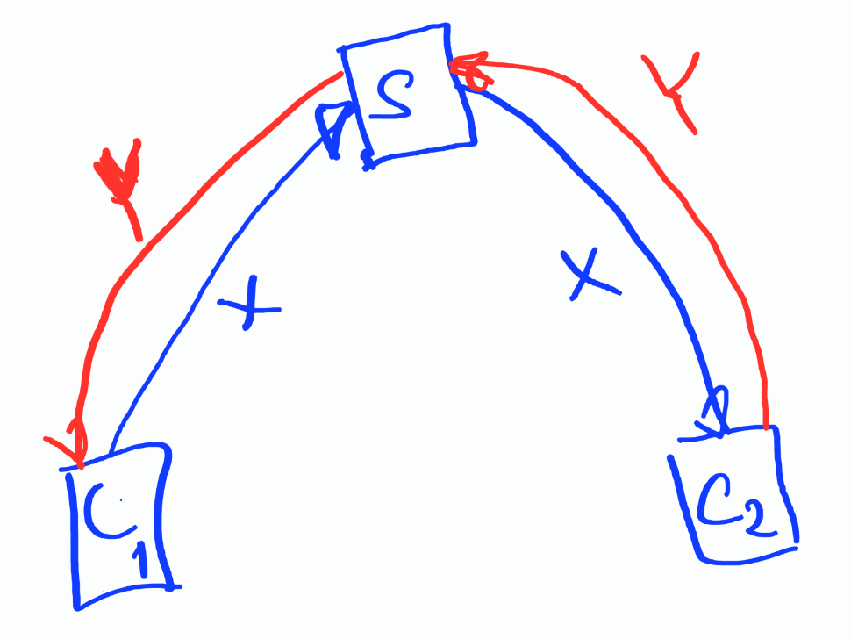
UDP Example
Revise client and server so that
One server will work with 2 (or more)s clients
Whenever the server receives a message from one client, it sends the message to the other client

Slide 27
UDP Broadcasting
Broadcast address: All of bits in hostID are 1
Local: 255.255.255.255
Broadcasting: send data with destination address as a broadcast address
Only broadcast on UDP
SocketAPI: SO_BROADCAST Socket Option

Slide 28
UDP Broadcasting
int n;
const int on = 1;
char sendline[MAXLINE], recvline[MAXLINE + 1];
socklen_t servlen;
struct sockaddr *preply_addr;
preply_addr = malloc(servlen);
setsockopt(sockfd, SOL_SOCKET, SO_BROADCAST, &on, sizeof(on));
sendto(sockfd, sendline, strlen(sendline), 0, servaddr, servlen);

Slide 29
UDP Broadcasting
for ( ; ; ) {
len = servlen;
n = recvfrom(sockfd, recvline, MAXLINE, 0, preply_addr, &len);
if (n < 0) {
printf("recvfrom error");
} else {
recvline[n] = 0;
printf("%s",recvline);
}
}

Slide 30
Q&A

